Slide 1
Face Detection

Slide 2
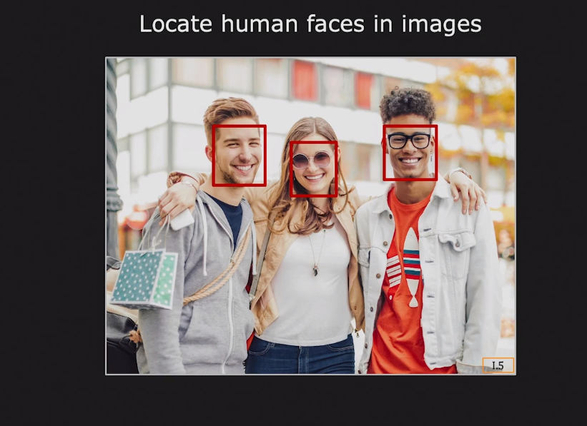
What is Face Detection ?

Slide 3
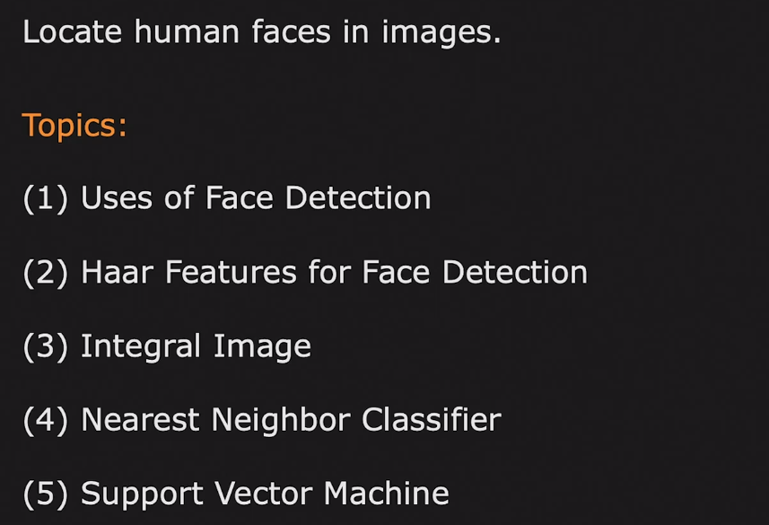
Face Detection

Slide 4
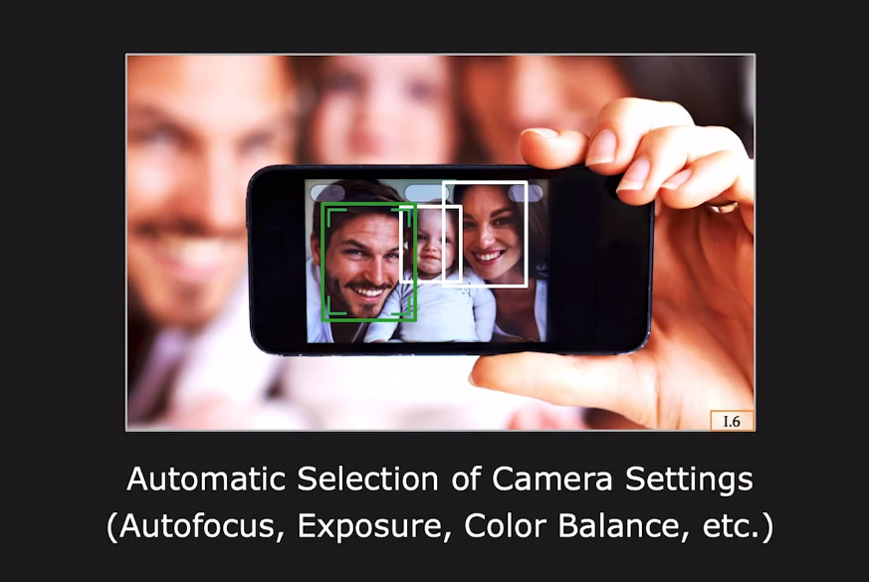
Face Detection uses

Slide 5
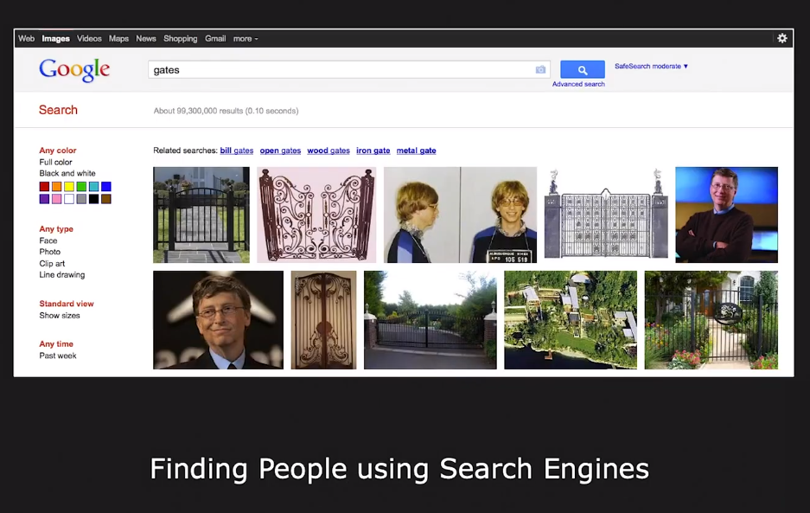
Face Detection uses

Slide 6
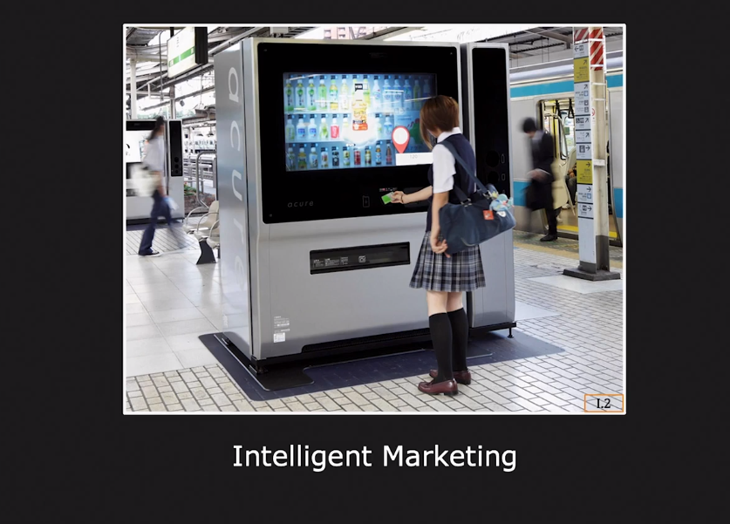
Face Detection uses

Slide 7
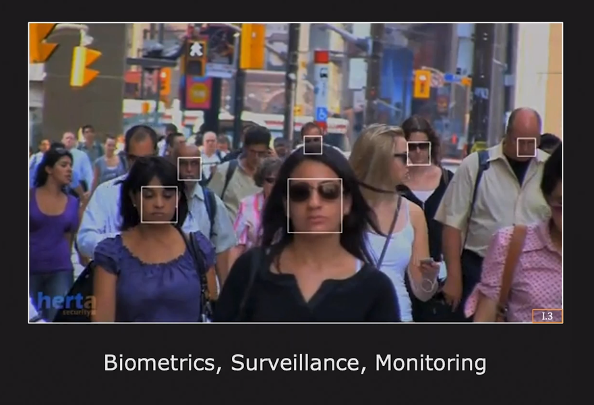
Face Detection uses

Slide 8
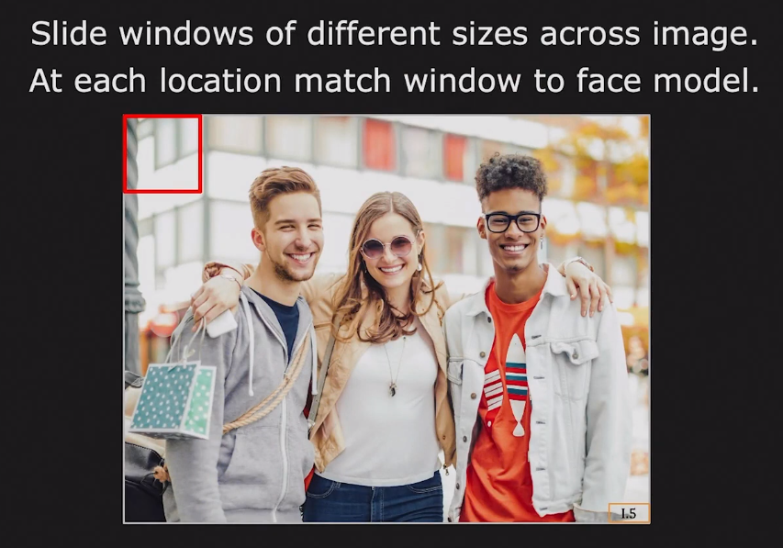
Face Detection in Computers

Slide 9
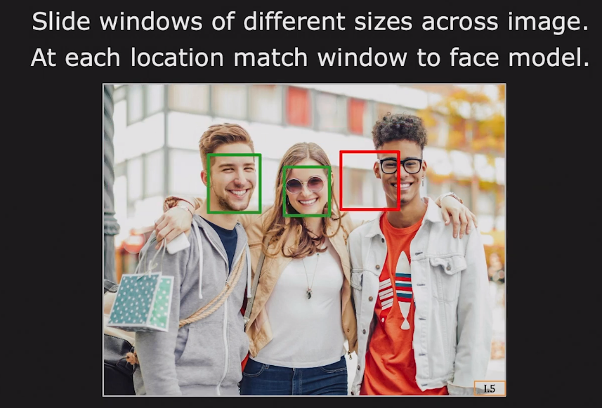
Face Detection in Computers

Slide 10
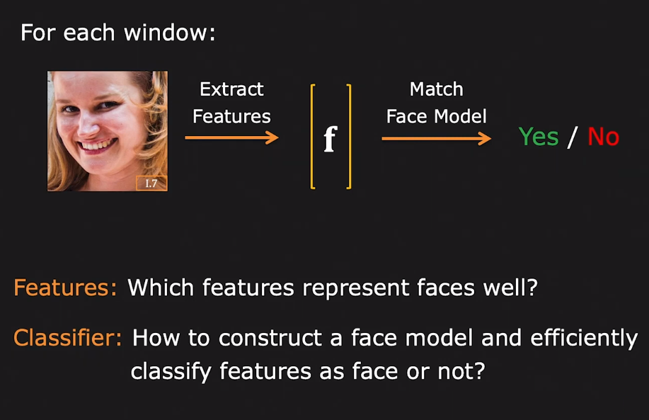
Face Detection Framework

Slide 11
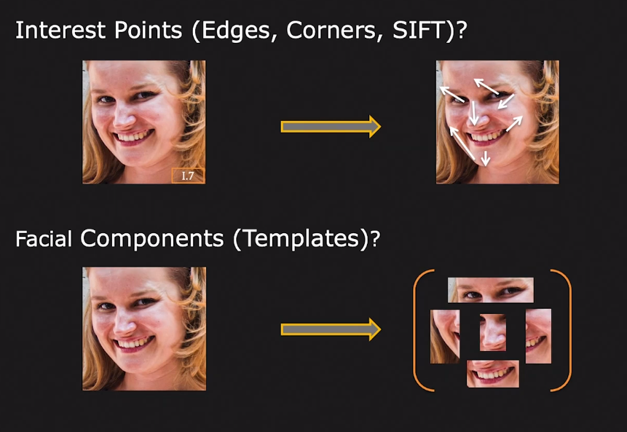
Face Detection: What are good features?

Slide 12
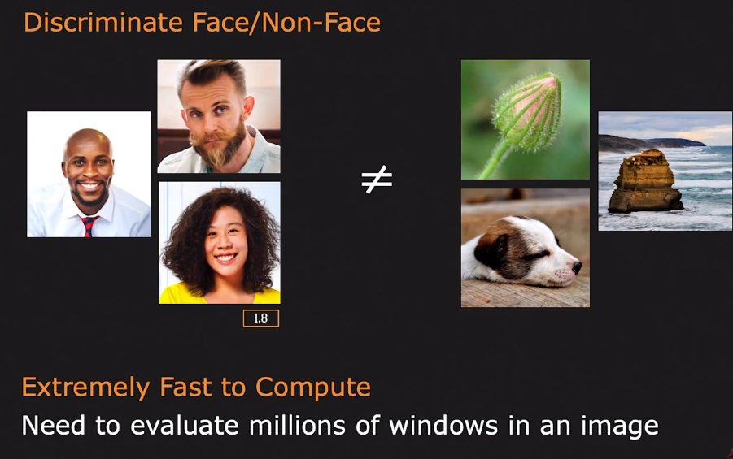
Characteristics of Good Features

Slide 13
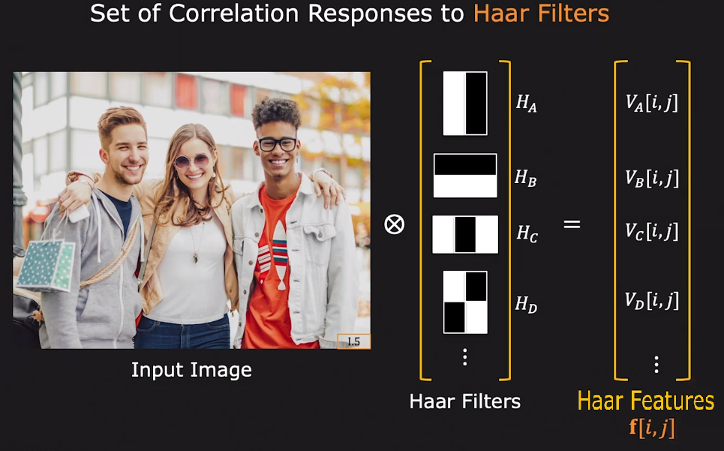
Haar Features

Slide 14
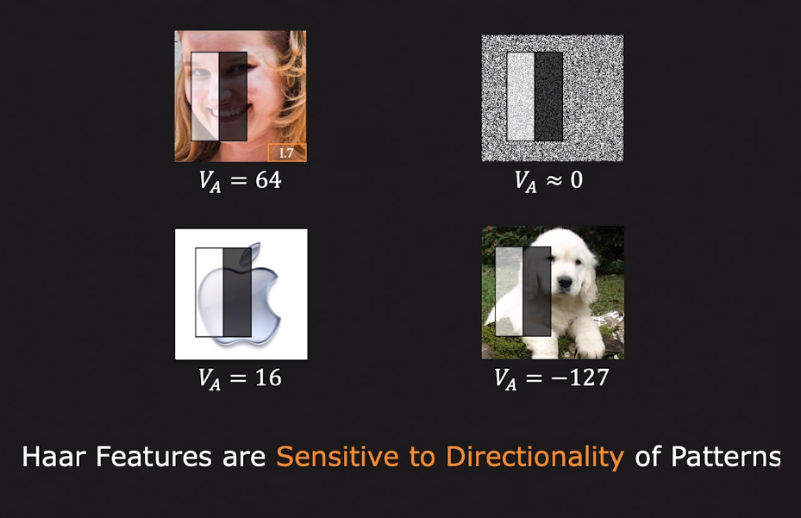
Discriminative Ability of Haar Feature

Slide 15
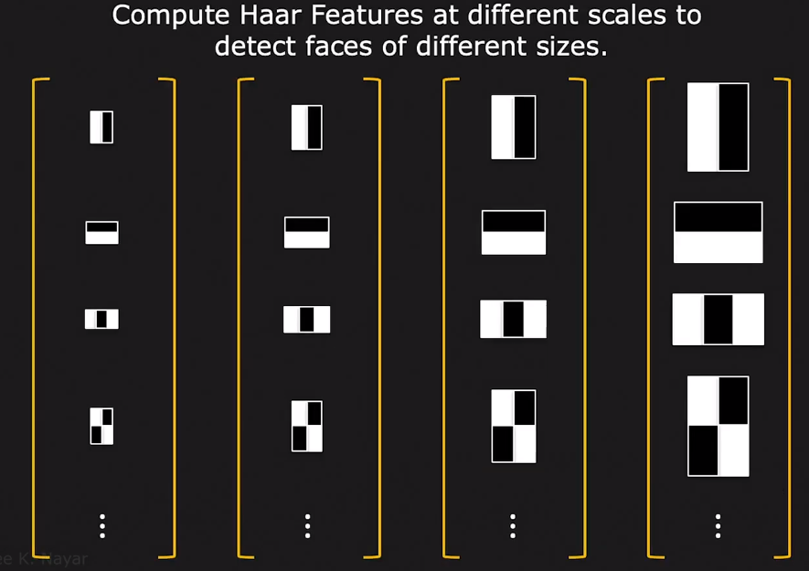
Detecting Faces of Different Sizes

Slide 16
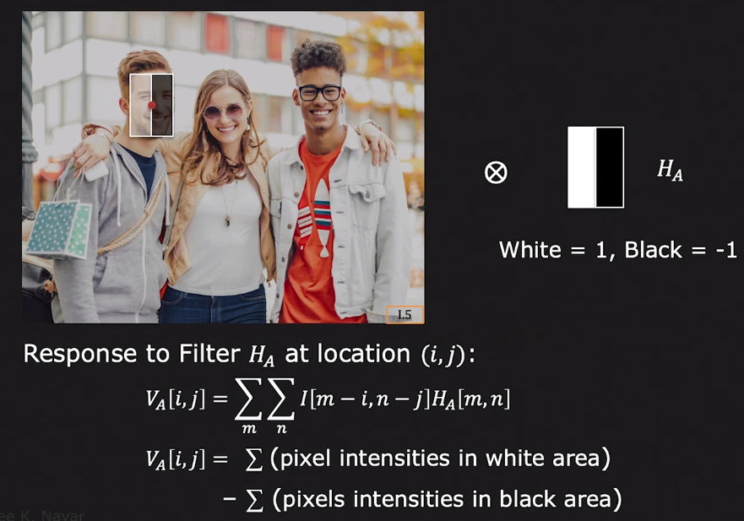
Computing Haar Feature

Slide 17
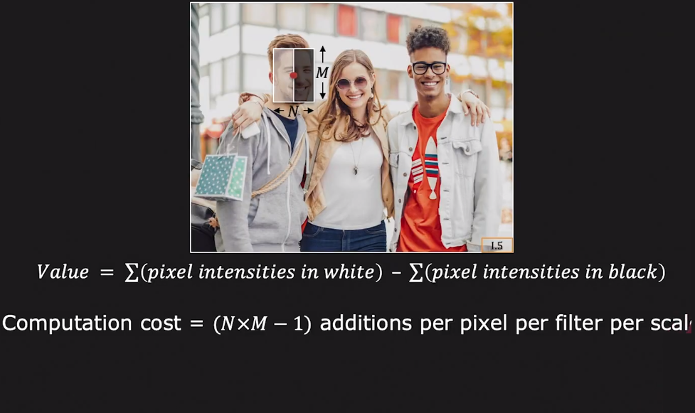
Discriminative Ability of Haar Feature

Slide 18
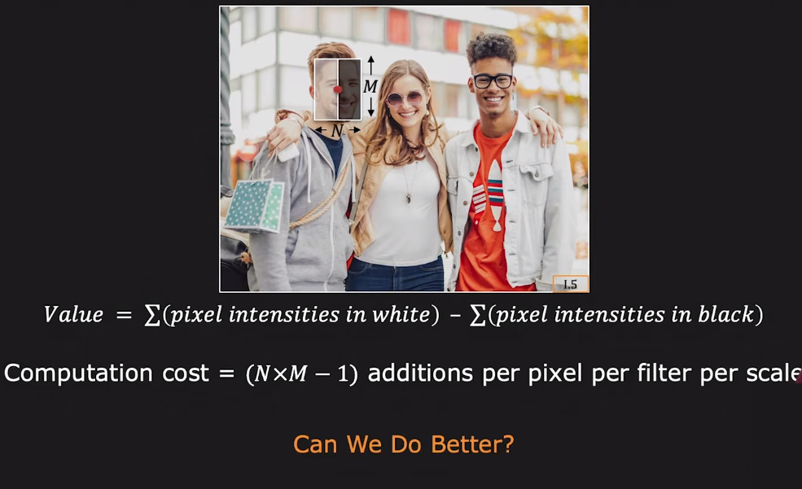
Discriminative Ability of Haar Feature

Slide 19
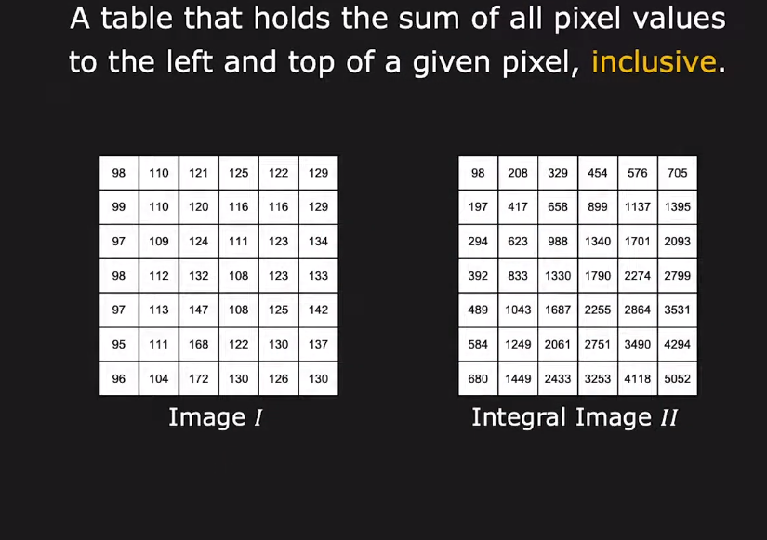
Integral Image

Slide 20
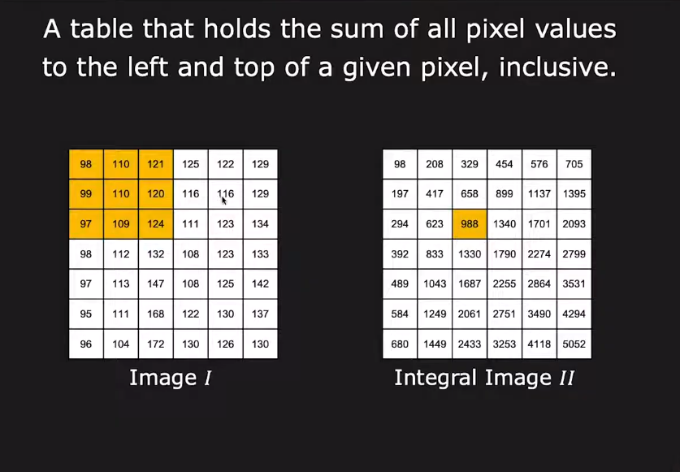
Integral Image

Slide 21
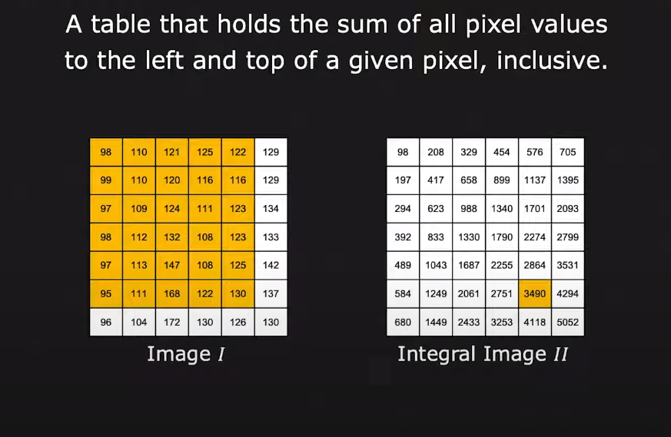
Integral Image

Slide 22
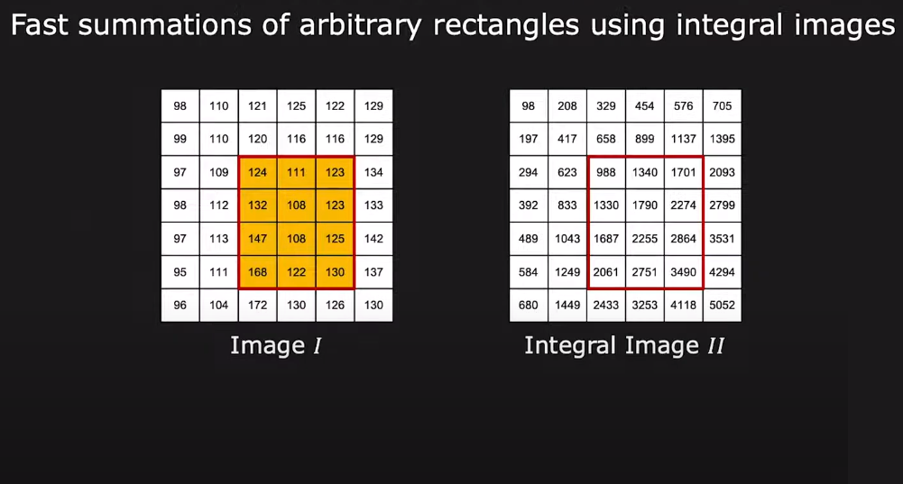
Summation within a rectangle

Slide 23
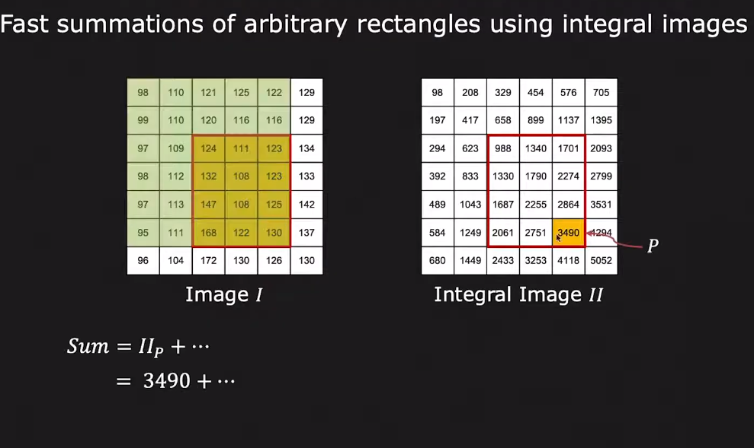
Summation within a rectangle

Slide 24
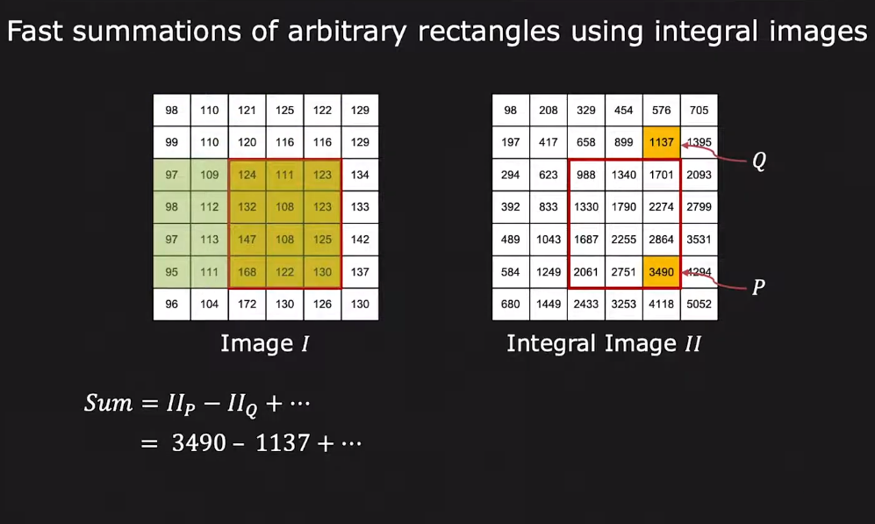
Summation within a rectangle

Slide 25
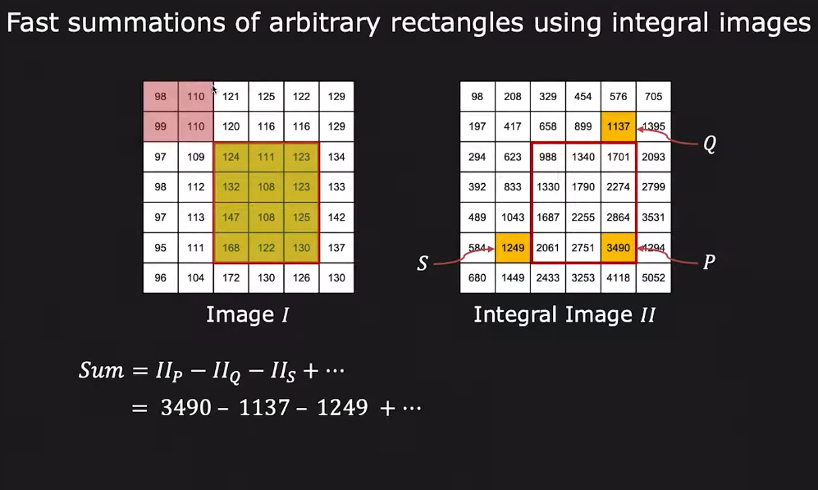
Summation within a rectangle

Slide 26
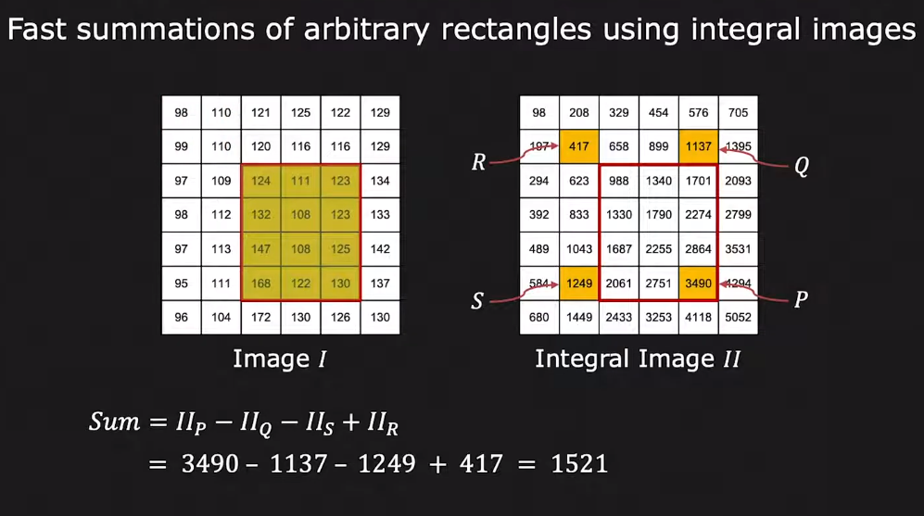
Summation within a rectangle

Slide 27
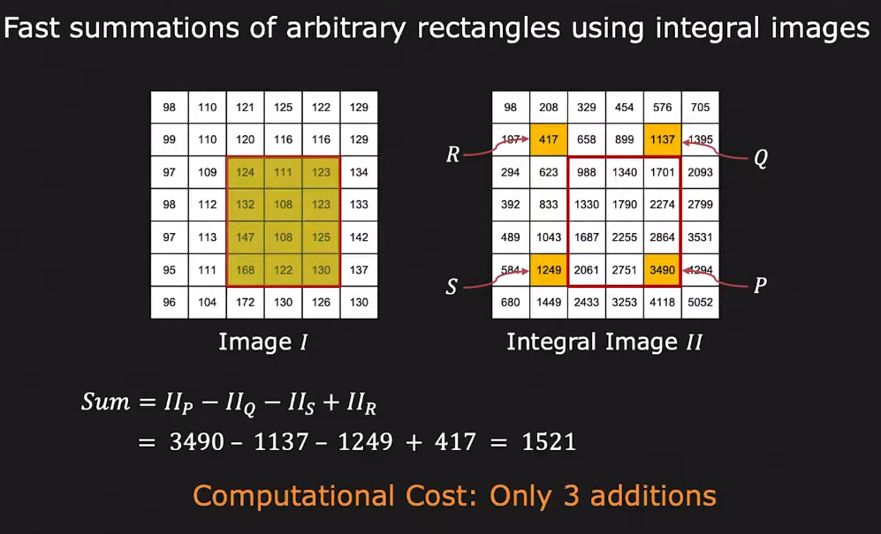
Summation within a rectangle

Slide 28
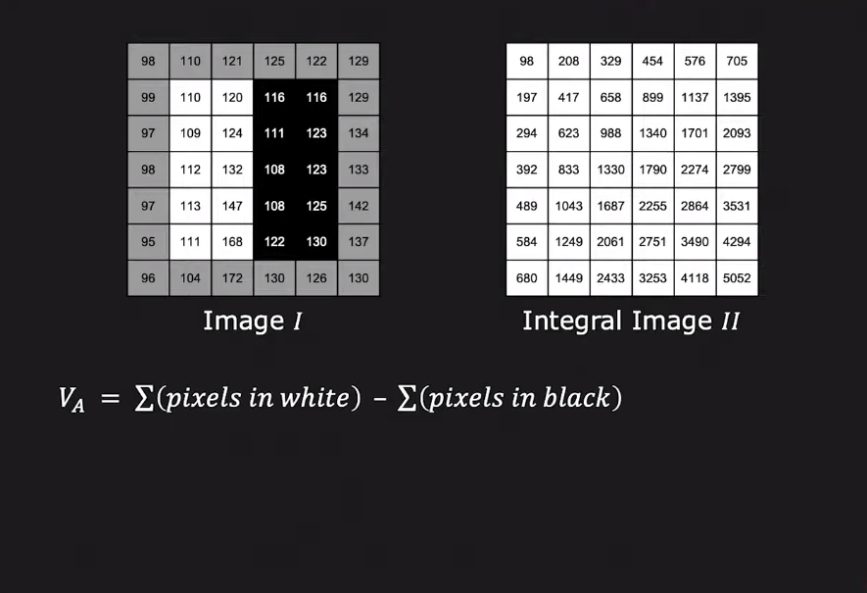
Haar Response using Integral Image

Slide 29
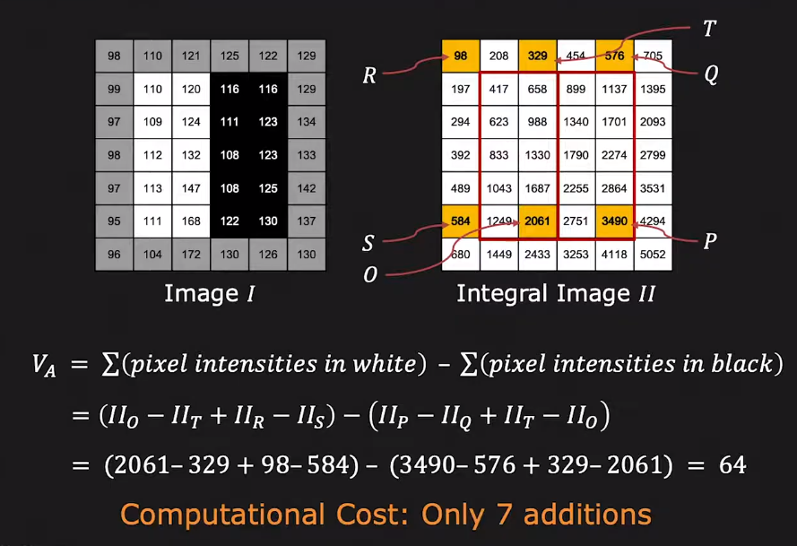
Haar Response using Integral Image

Slide 30
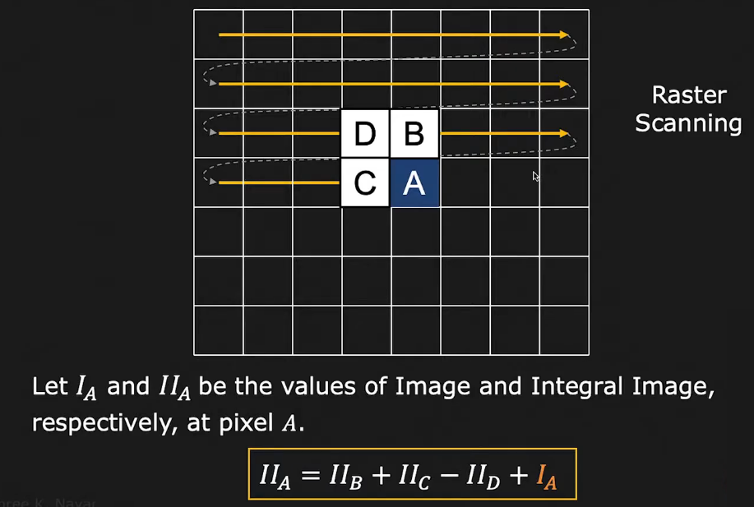
Computing Integral Image

Slide 31
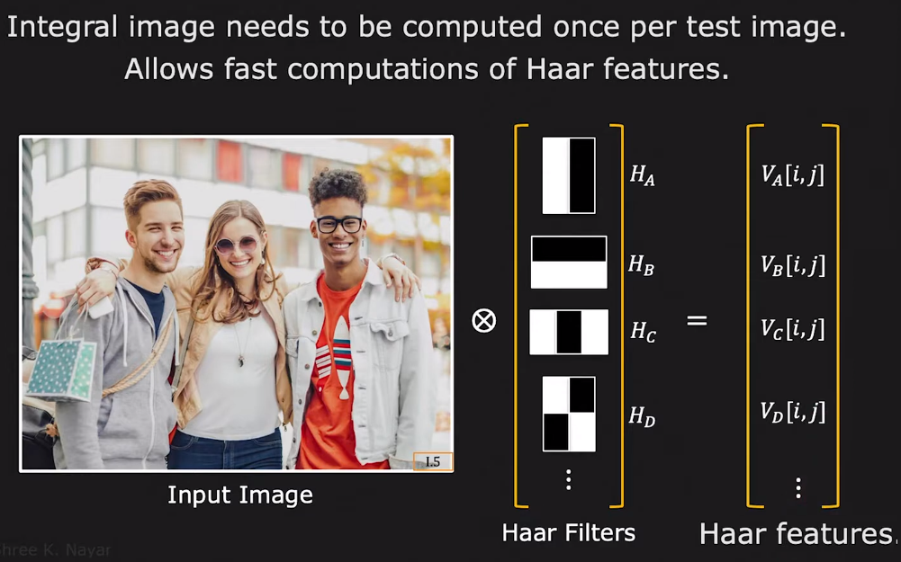
Haar Features using Integral Images

Slide 32
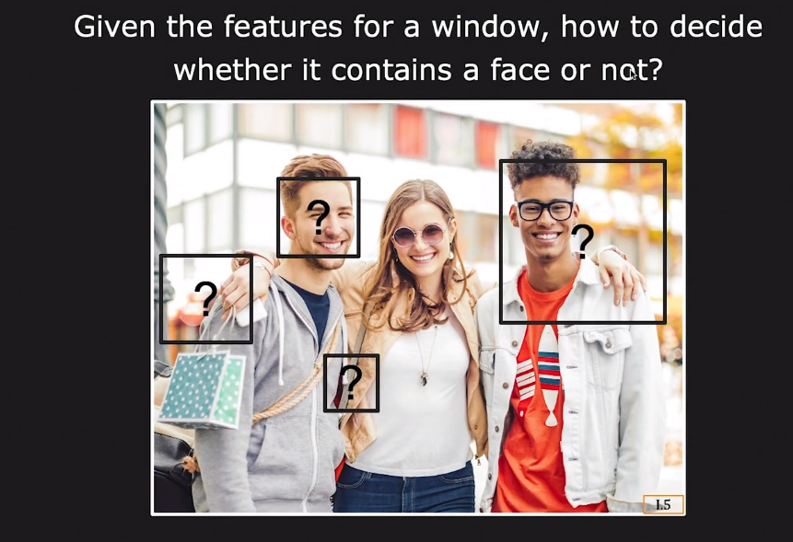
Classifier for face detection

Slide 33
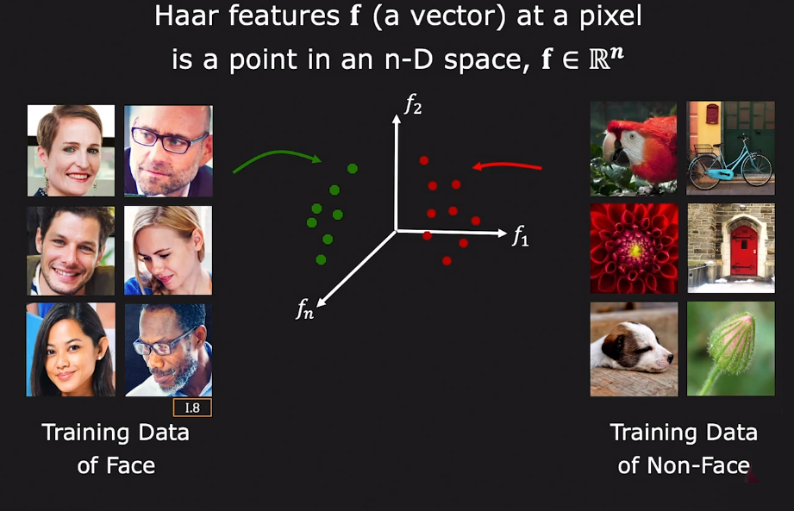
Feature Space

Slide 34
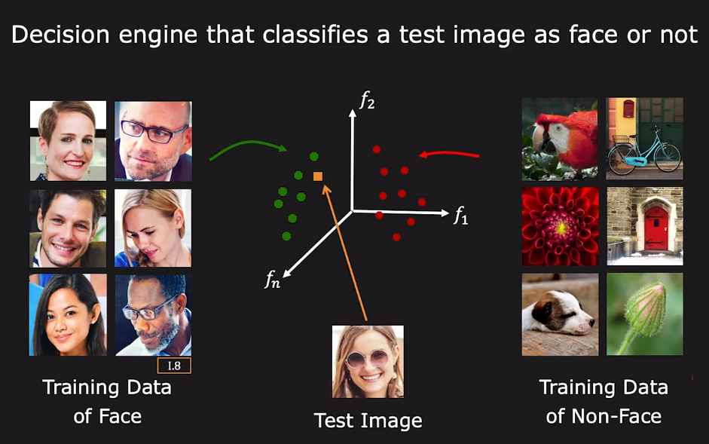
Classifier

Slide 35
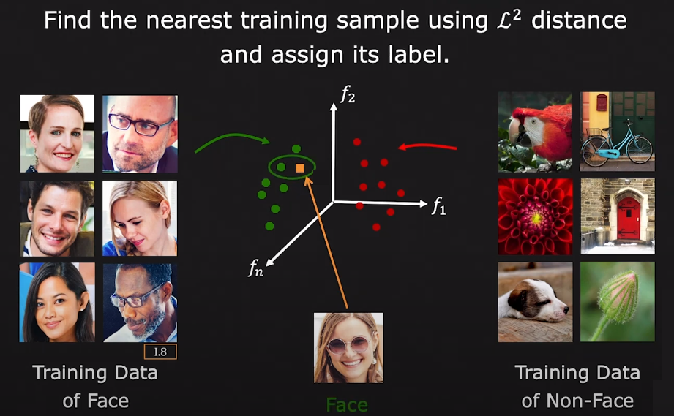
Nearest Neighbor Classifier

Slide 36
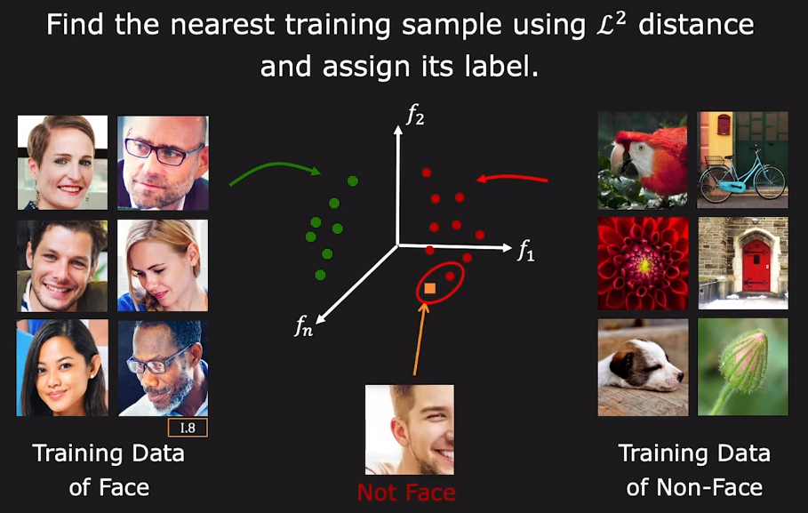
Nearest Neighbor Classifier

Slide 37
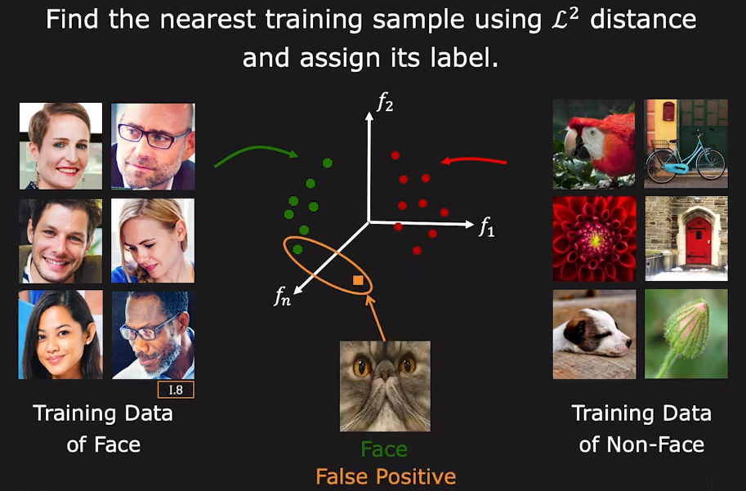
Nearest Neighbor Classifier

Slide 38
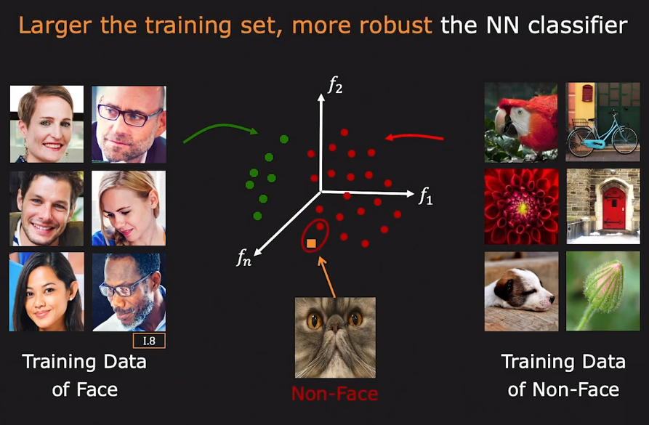
Nearest Neighbor Classifier

Slide 39
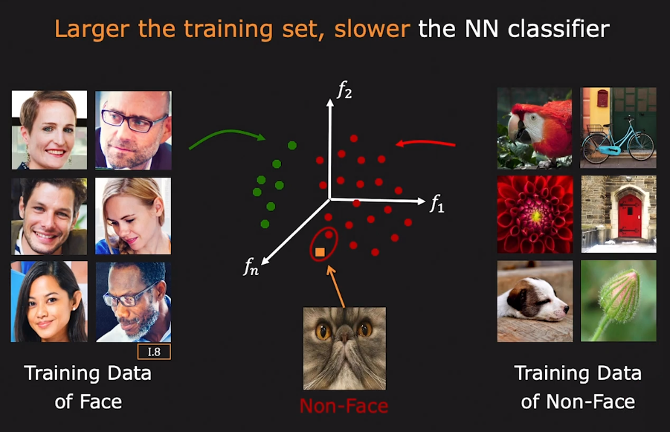
Nearest Neighbor Classifier

Slide 40
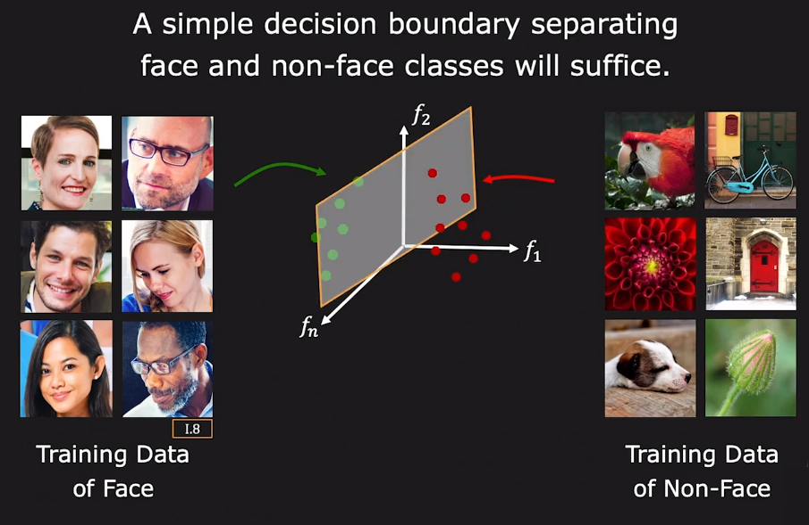
Decision Boundary

Slide 41
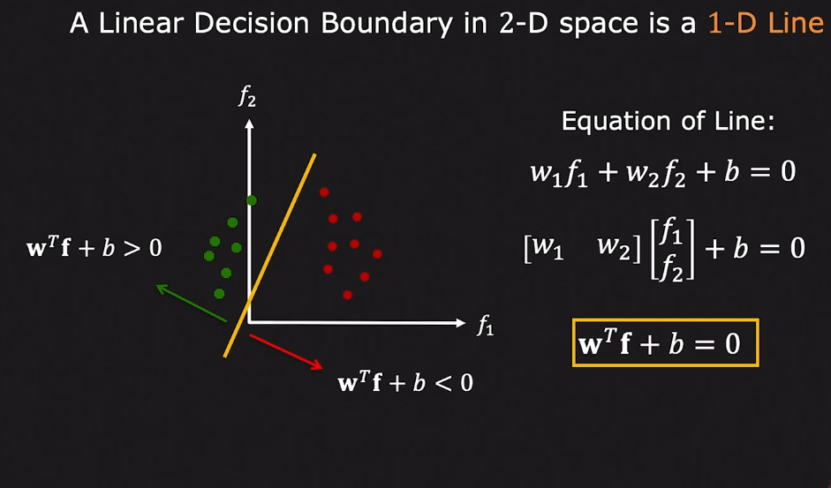
Linear Decision Boundary

Slide 42
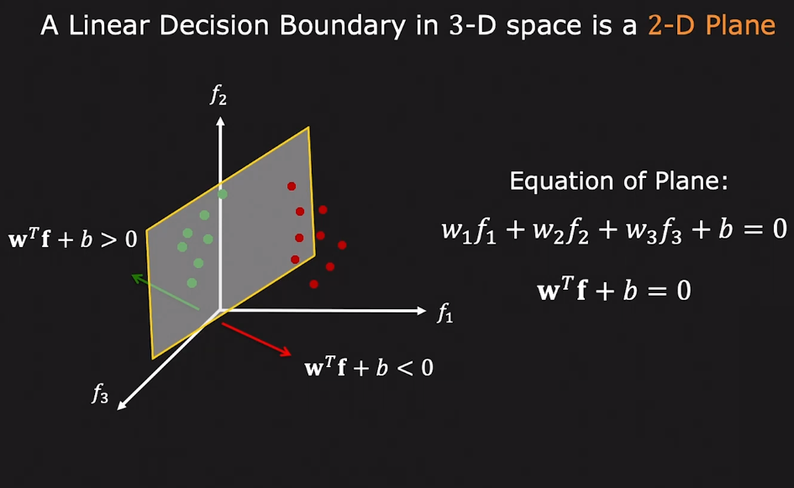
Linear Decision Boundary

Slide 43
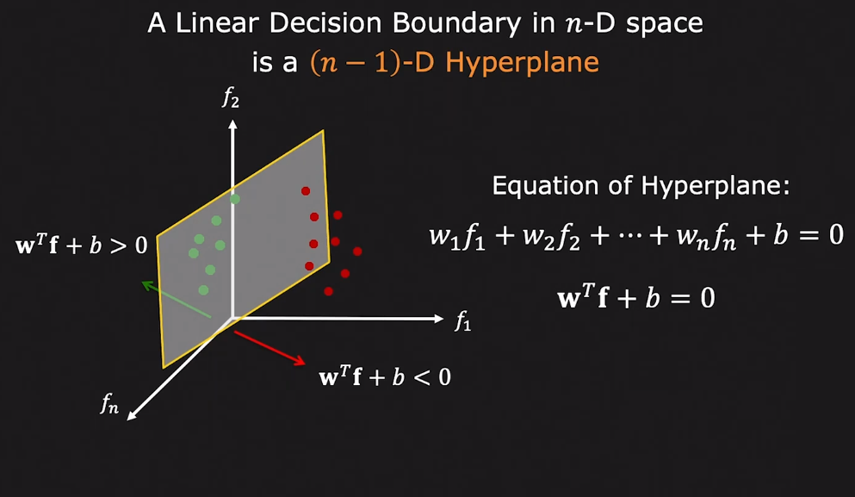
Linear Decision Boundary

Slide 44
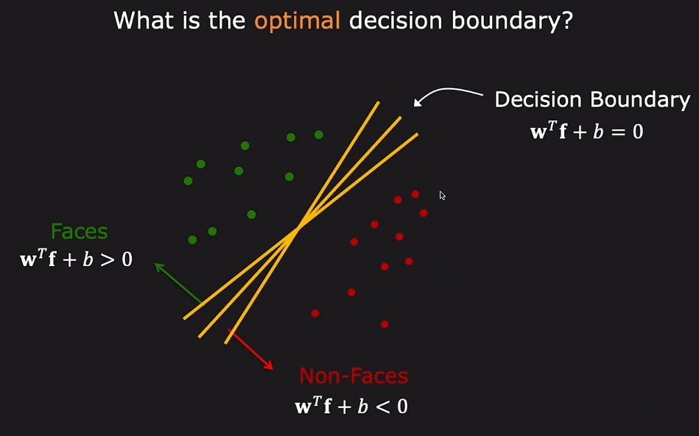
Decision Boundary (w, b)

Slide 45
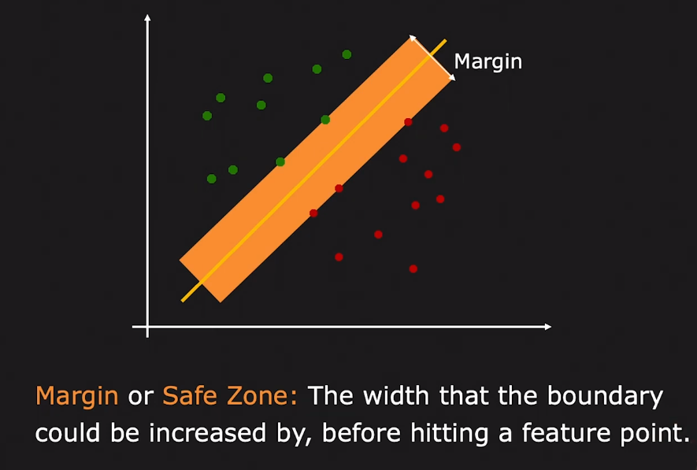
Evaluating a Decision Boundary

Slide 46
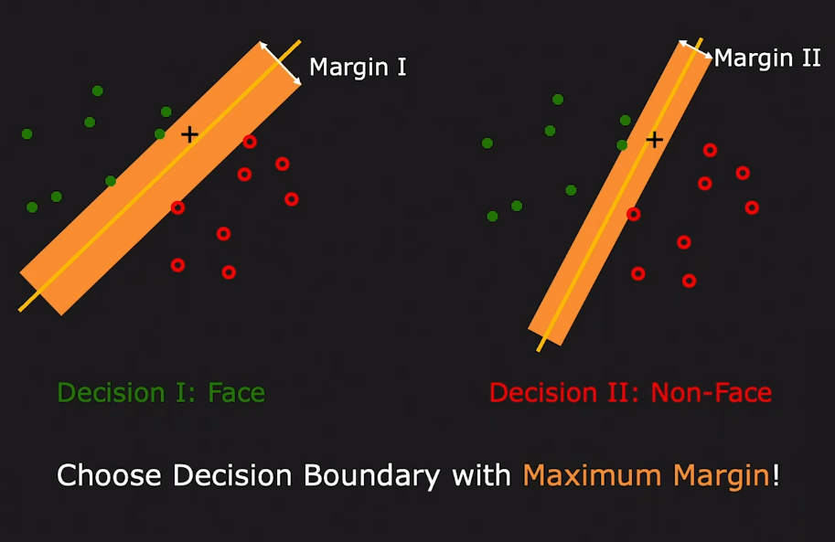
Evaluating a Decision Boundary

Slide 47
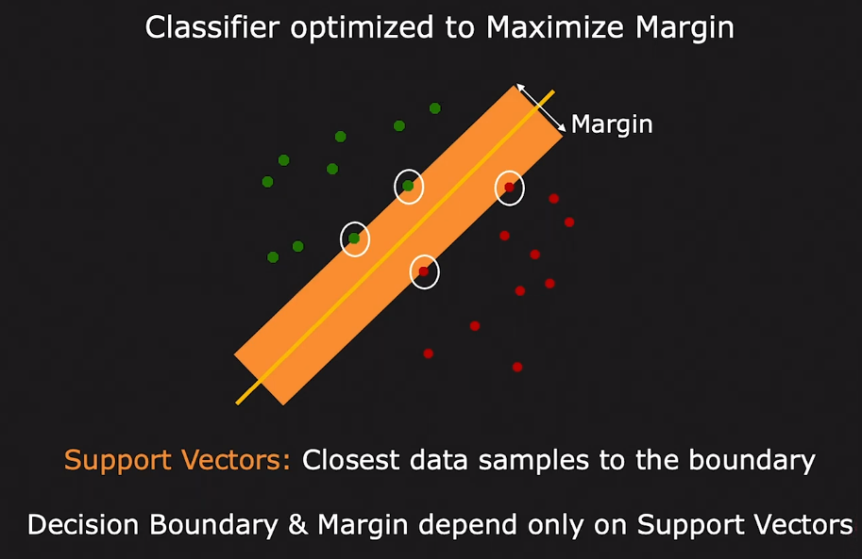
Support Vector Machine (SVM)

Slide 48
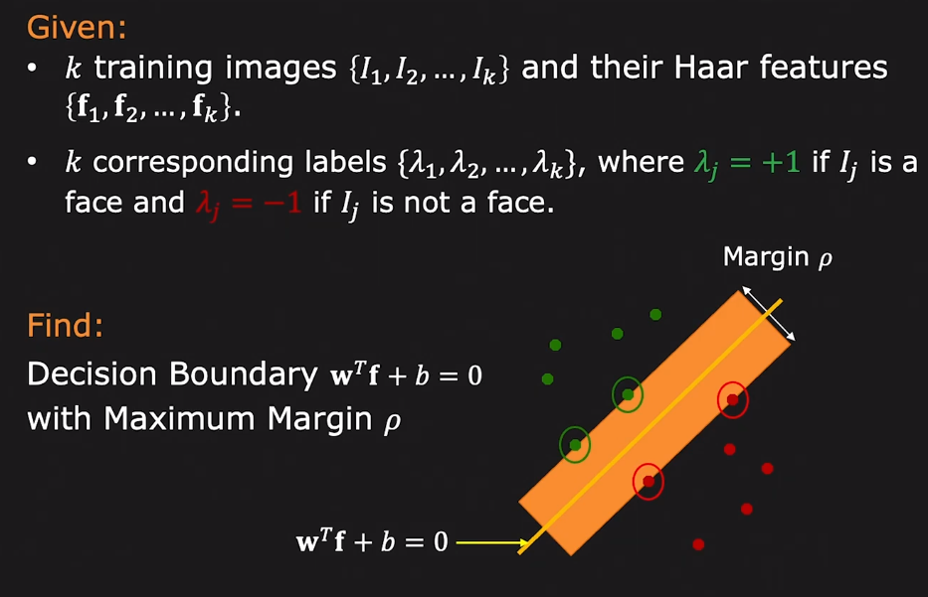
Support Vector Machine (SVM)

Slide 49
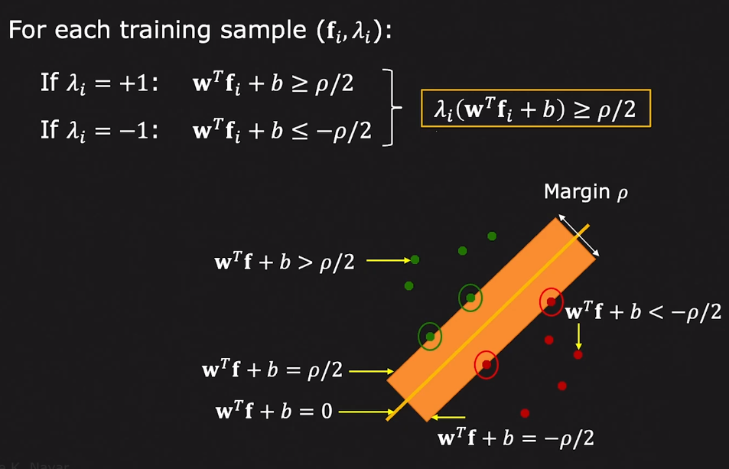
Support Vector Machine (SVM)

Slide 50
Finding Decision Boundary (w, b)

Slide 51
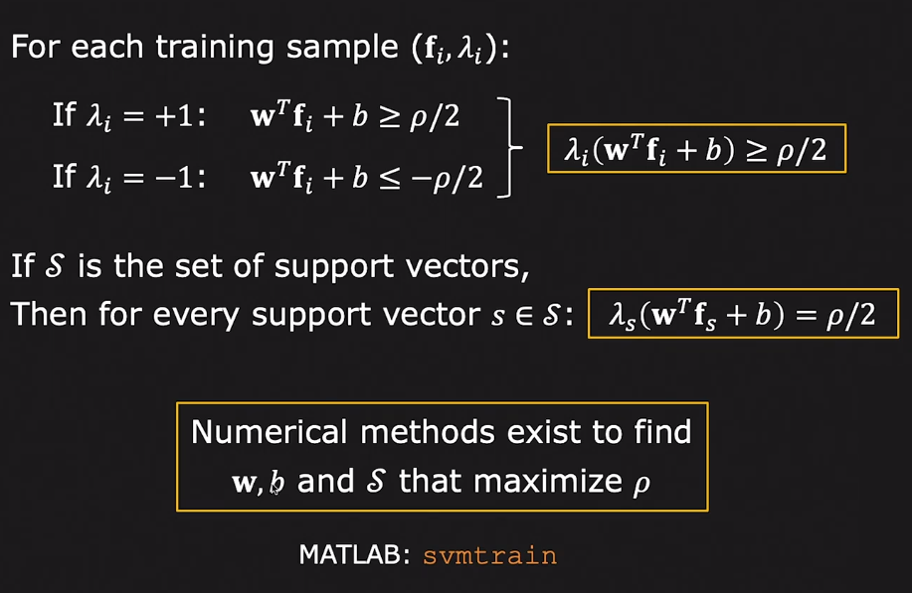
Finding Decision Boundary (w, b)

Slide 52
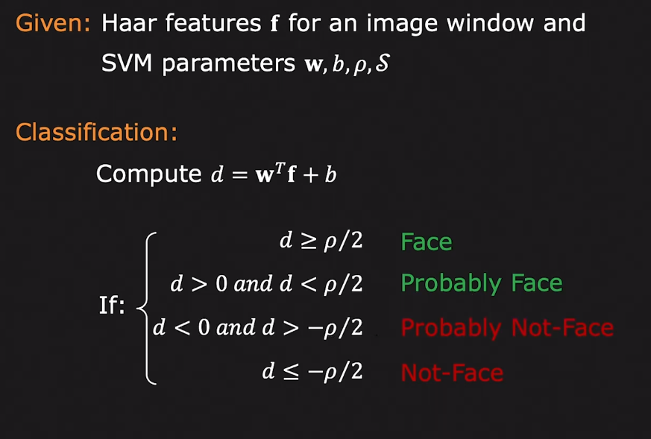
Face detection using Haar and SVM

Slide 53

Face Detection Results

Slide 54
Thanks

